Slide 1
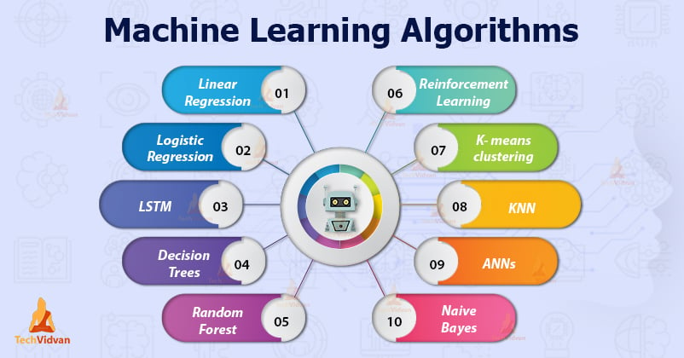
Machine Learning And Its Concepts

Slide 2
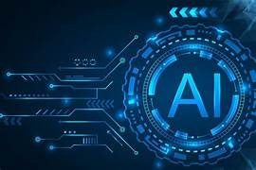
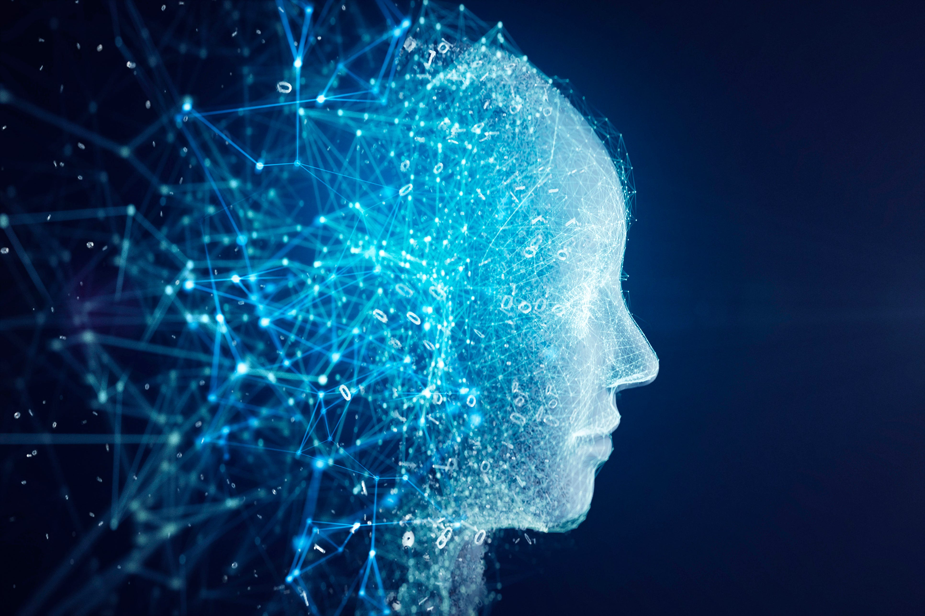
Artificial intelligence
Artificial intelligence (AI), the ability of a digital computer or computer-controlled robot to perform tasks commonly associated with intelligent beings
In simple words it means to mimic human beings in computer. It can also be defined as human intelligence in machines.

Slide 3
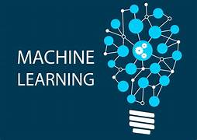
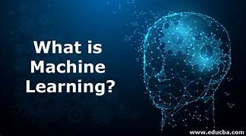
Machine learning
Machine learning is a branch of artificial intelligence (AI) and computer science which focuses on the use of data and algorithms to imitate the way that humans learn, gradually improving its accuracy.
It is way in which machines are made to learn things like human beings

Slide 4
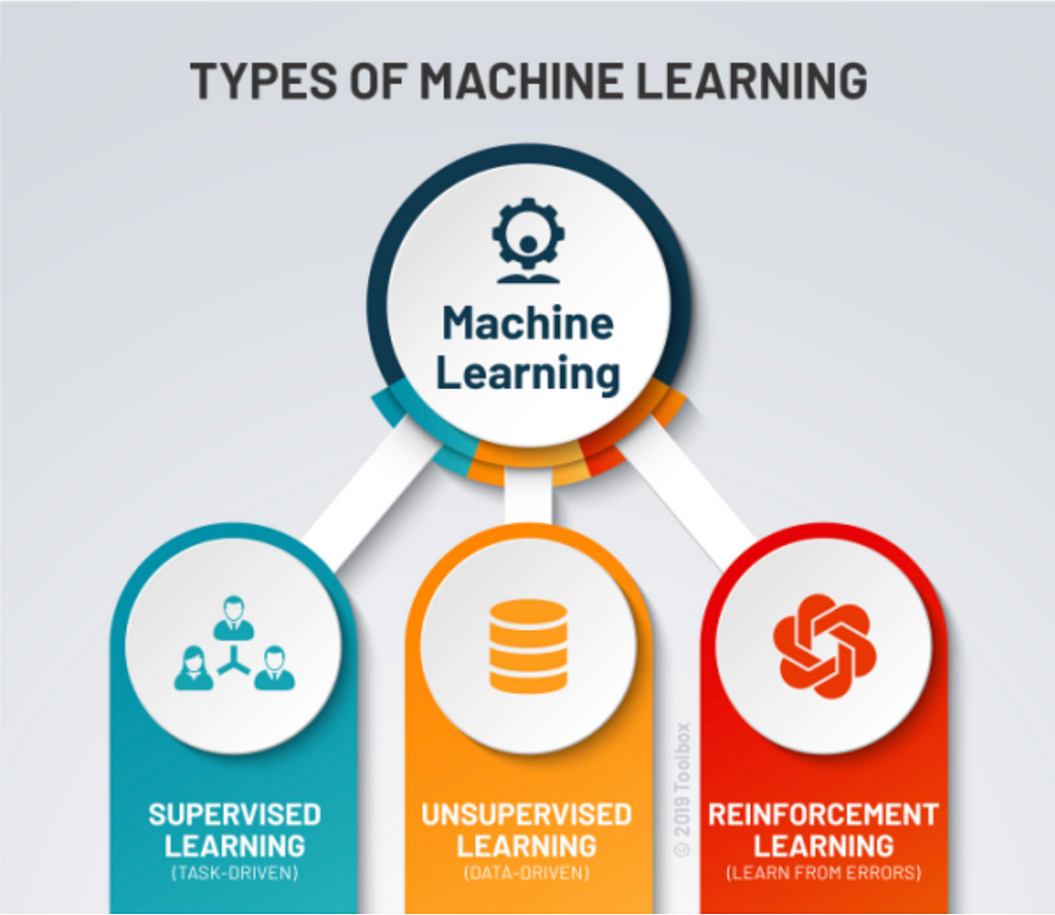
Types of Machine Learning:
1.Supervised Learning
2.Unsupervised Learning
3.Reinforcement Learning

Slide 5
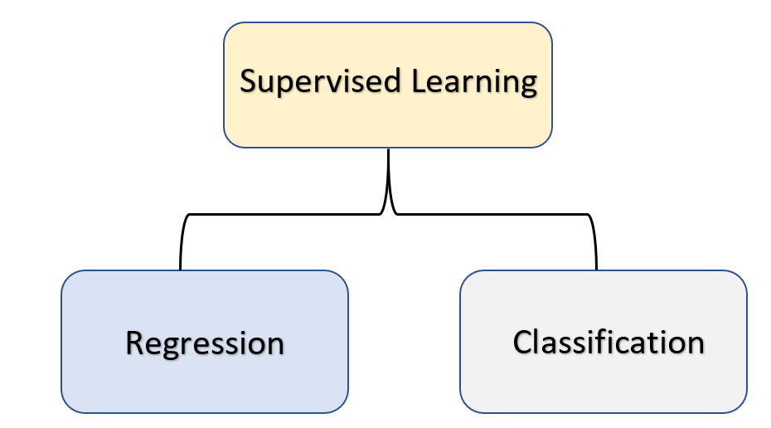
Supervised machine learning
Supervised learning, also known as supervised machine learning, is defined by its use of labeled datasets to train algorithms to classify data or predict outcomes accurately. As input data is fed into the model, the model adjusts its weights until it has been fitted appropriately.
Key points:
1.Learning from others , under some guidance
2.Features and Labels
3.Two types of algorithms : Regression & classification

Slide 6
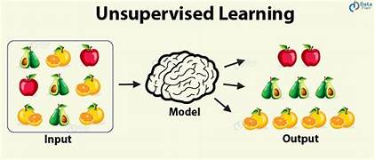
Unsupervised machine learning
Unsupervised learning, also known as unsupervised machine learning, uses machine learning algorithms to analyze and cluster unlabeled datasets. These algorithms discover hidden patterns or data groupings without the need for human intervention.
Key points:
1.Learning on our own without taking the help of others by books , online etc.
2.Only features
3.Clustering and association

Slide 7
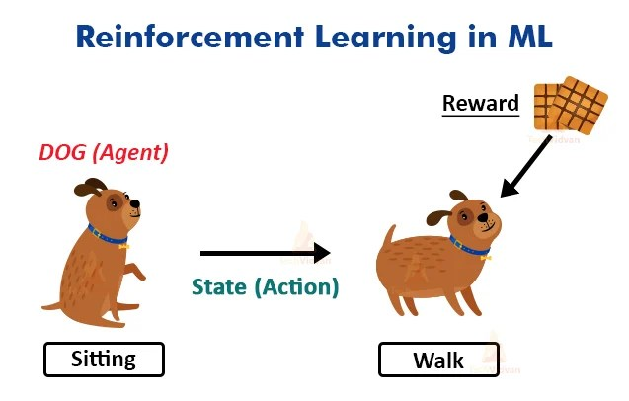
Reinforcement machine learning
Reinforcement machine learning is a machine learning model that is similar to supervised learning, but the algorithm isn’t trained using sample data. This model learns as it goes by using trial and error.
Key points:
1.Learning by the process of rewards and penalty.
2.The agent is rewarded for every correct point and penalized (penalty) for every wrong answer.

Slide 8
Difference b/w M.L & D.L
Machine learning:- We give input and output to the machine learning algorithm it builds a model.
INPUT BUILDS
OUTPUT MODEL
Deep learning:- We give input and output to the neural networks it builds a model.
INPUT BUILDS
OUTPUT MODEL
MACHINE LEARNING ALGORITM
ARTIFICIAL NEURAL NETWORKS

Slide 9
Machine learning-Algorithms
Linear Regression:- It is a method used to predict the dependent variable(y) based on the independent variable(x) .
Logistic regression:- It is a method used to predict a dependent variable , given a set of independent variable.
Decision tree:- In this algorithm the final decision is made by a single person (or) one person.
Random forest:-Random forest is constructed using multiple decision trees and the final decision is obtained by majority votes .
K nearest neighbor (KNN):- The nearest neighbor based on similar characteristics.
Support vector mission (SVM):- selected (or) grouped on the basis of similar features.
Naive Bayes algorithm:- it is an algorithm used for solving classification machine learning problems.

Slide 10
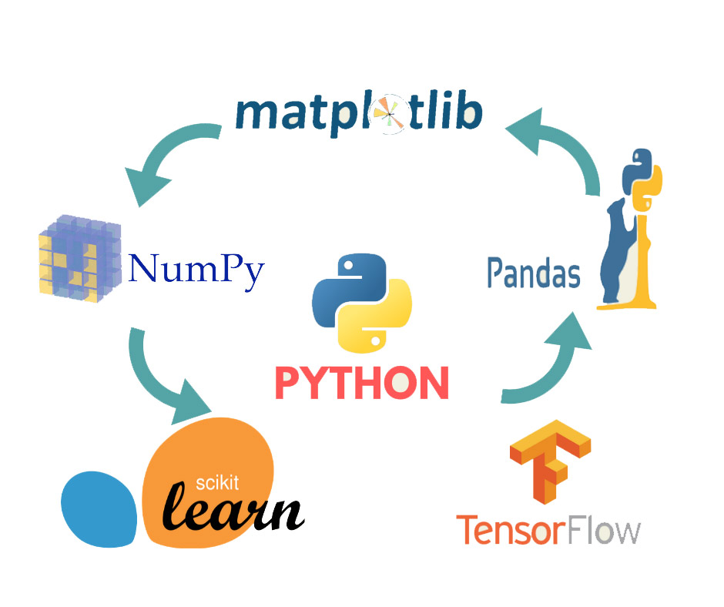
Library Used for Machine Learning
Numpy: Python number source library
Scipy: Python scientific library
Matplotlib: Graph representation
Pandas: Data analysis subset of database
Scikit learn: Writing ML programs

Slide 11
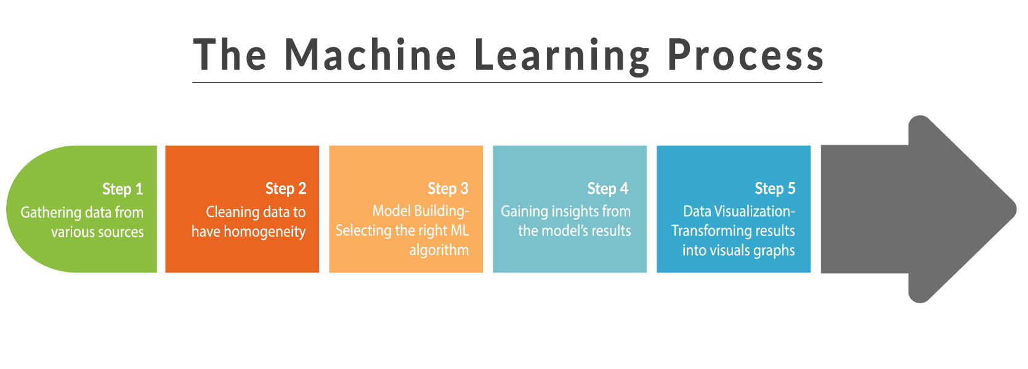
Steps Involved in Machine Learning Programming
1.Get the data/ collect the data: Kaggle
2.Identifying the Algorithm:
a. Regression
b. Classification
3. 3 Steps
a. Fit: Input and output the model
b. Predict: Take input and predict the model
c. Scores: Used for prediction accuracy

